Slide 1
Reinforcement Learning

Slide 2
Topics
About Reinforcement Learning
The Reinforcement Learning Problem
Inside An RL Agent
Problem within Reinforcement Learning

Slide 3
TextBook 1
An Introduction of Reinforcement Learning, Sutton and Barto, 1998
MIT Press, 1998
More intuitive

Slide 4
TextBook 2
Algorithm for Reinforcement Learning, Szepesvari
Morgan and Claypool, 2010
More Mathematics

Slide 5
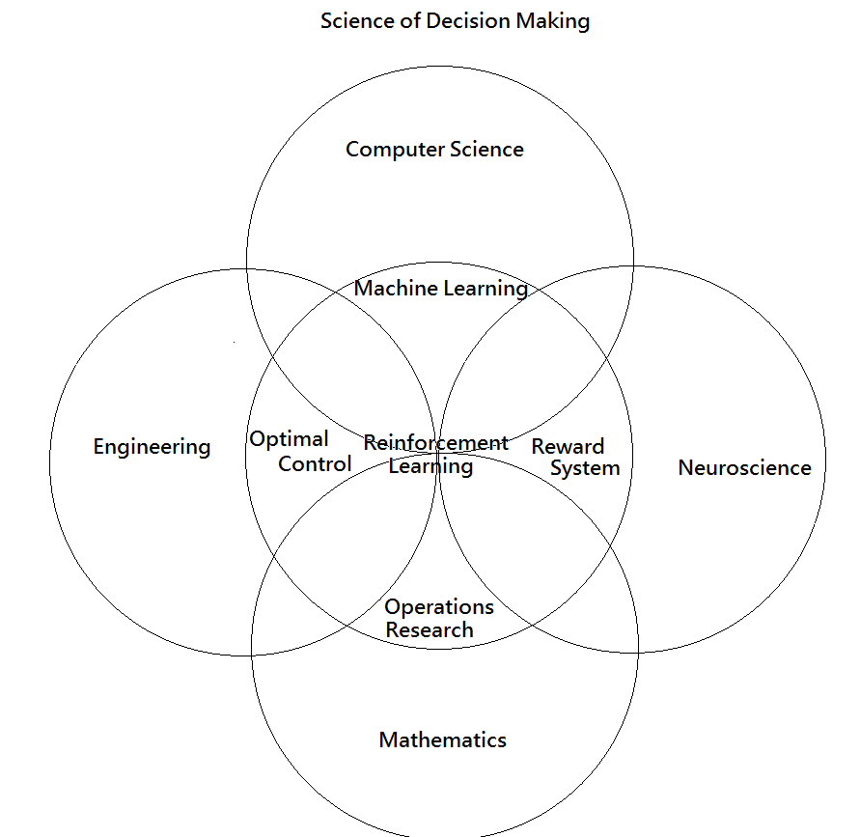
About Reinforcement Learning

Slide 6
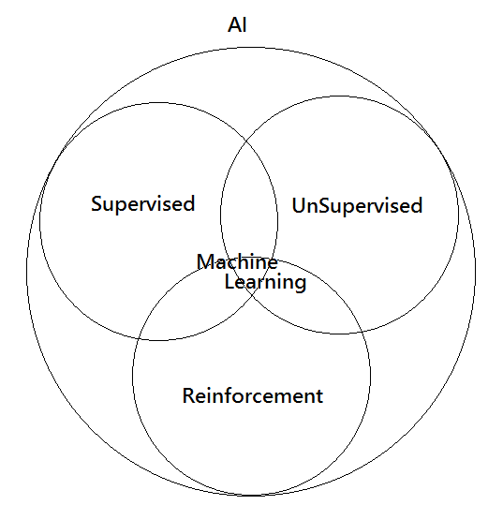
About Reinforcement Learning

Slide 7
About Reinforcement Learning
What is Reinforcement Learning different?
There is no supervisor, only a reward signal.
Feedback is delayed, not instantaneous.
Time really matter, (sequence of data it receives)
Agent’s action affect the subsequence data it receives.

Slide 8
About Reinforcement Learning
Example?
Helicopter control
Manage Investment Portfolio.
Control a power station.
Play many different Atari games better than humans.

Slide 9
The Reinforcement Learning Problem
Reward
Sequence of Decision Making (Action)
Agent and Environment
History and State
Environment State, Agent State

Slide 10
Reward
A Reward Rt is a scalar feedback signal.
Indicates how well agent is doing at step t
The agent’s job is to maximize Expected cumulative reward.

Slide 11
Reward
Example of Rewards
Fly helicopter
+ve reward for following desired trajectory
-ve reward for crashing
Manage Investment Portfolio.
+ve for each $ earn
-ve for each $ loss

Slide 12
Sequential decision Making(Action)
Goal: select action to maximize the total expected cumulative future rewards.
Reward may be delayed. Each action selected must think ahead.
It sometime may be better to sacrifice immediate reward to gain more long-term reward.

Slide 13
Sequential decision Making(Action)
Examples
A financial investment (may take months to mature)
Blocking an opponent move instead of take out the pawn. (for better strategic move to win the game)

Slide 14
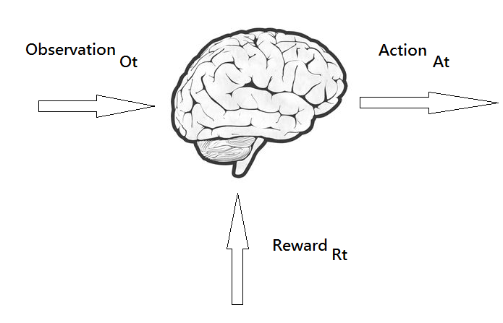
Agent and Environment

Slide 15
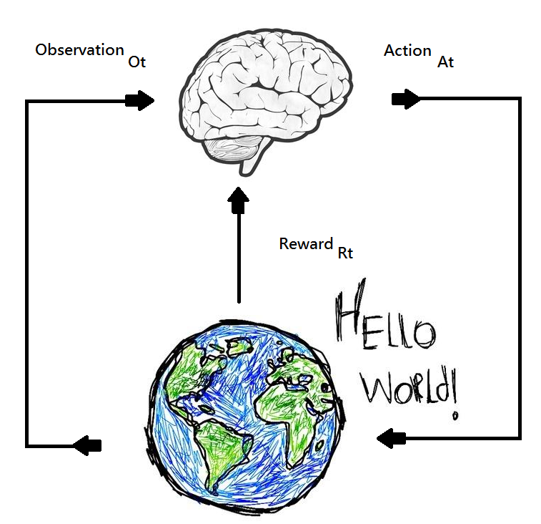
Agent and Environment
At each step the agent:
Take an action At
Receives observation Ot
Receives Scalar Reward Rt
At each step the environment:
Receives an action At
Emit observation Ot
Emits Scalar Reward Rt

Slide 16
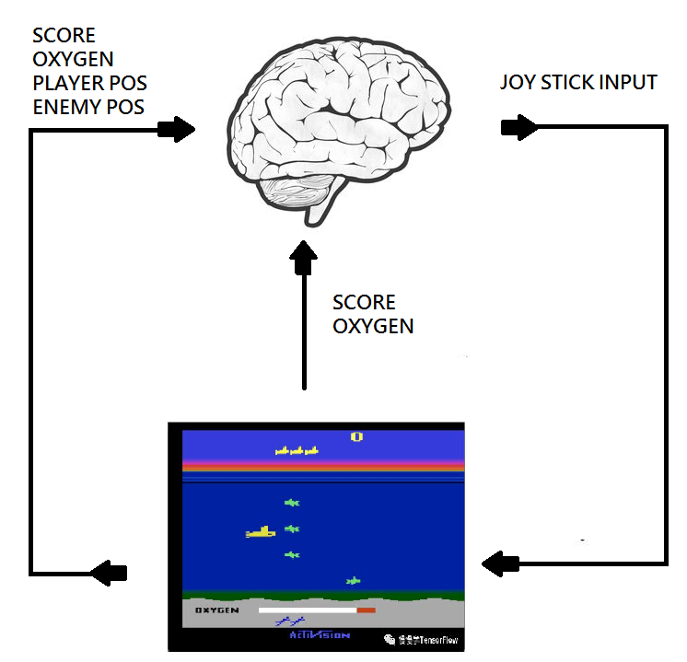
Agent and Environment
At each step the agent:
Take an action At
Receives observation Ot
Receives Scalar Reward Rt
At each step the agent:
Receives an action At
Emmit observation Ot
Emits Scalar Reward Rt

Slide 17
History and State
The history is the sequence of observations, Actions and Rewards.
Ht = A1O1R1, A2O2R2,……AtOtRt
i.e. all observable variables up to time t
What happens next depends on history Ht.
The agent selects actions depends on Ht.
The environment selects observations/rewards depends on Ht.

Slide 18
History and State
Goal: build a mapping
At = f1(Ht)
Ot = f2(Ht)
Rt = f3(Ht)

Slide 19
History and State
Usually, Ht is usually too big and is not useful in most case.
State: A concise summary used to determine what happens next.
Capture only the necessary information needed.
Goal: build a mapping
At = f1(St)
Ot = f2(St)
Rt = f3(St)

Slide 20


Environment State, Agent State
Environment State:
The Environment State is the environment’s private representation.
i.e. whatever data the environment uses to pick the next observation / reward Ot = f2( ), Rt = f3( )
The environment state is not usually visible to the agent
Even if is visible, it may contains irrelevant information.
e.g. all memory in the used by the game program.

Slide 21


Environment State, Agent State
Agent State:
The agent State is the agent’s internal state representation
i.e. whatever data the agent used to pick action
At = f1( )
= f1(Ht)

Slide 22


State: Markov State
A State is Markov (has Markov property) if and only if
The future is independent to the past given the present.
If a state is Markov, you only need to keep the current state in order to decide next state.
Can throw away the past state.

